Slide 1

Competitive Intelligence & Buyer Persona’s
HITACHI CONFIDENTIAL
Who are your Prospects and what are their roles?
Who are your Competitors and what are their strengths and weaknesses?
What are the relevant security technologies in the industry and how do they work?
A Hitachi Group Company

Slide 2
Buyer Personas & Buyer Discussions
HITACHI CONFIDENTIAL
Who are your Prospects and what are their roles?
Hitachi Systems Security Internal Training
A Hitachi Group Company

Slide 3

CISO/CIO Persona
Position | Priorities
CISO, CIO, or Head of Information Security (Economic) | Responsibilities: Responsible for ensuring all data and/or network assets are adequately protected Establishes the information security vision across the enterprise Make strategic direction and investment decisions Focus: Securing corporate data, InfoSec financial planning, reporting risk to executive Team

Slide 4

Director of IT Sec Persona
Position | Priorities
InfoSec, Security Operations (SOC), or Cyber Incident Response Team (CIRT) Director or Manager (Technology) | Responsibilities: Understand the Security posture of the organization and between people, processes and technology Implement security strategy and processes Evaluate requirements and processes to execute strategy Develop and maintain incident response plans Focus: Management and reporting Respond to network/data breaches Evaluate and decide on security technology and process

Slide 5

Tier 1 Info Sec Persona
Position | Priorities
Tier 1 InfoSec, Incident Response (IR), or Threat Intelligence (TI) Engineer (Functional) | Responsibilities: Interacts directly with InfoSec software investments Maintaining threat intelligence and scanning for new threats First line of defense for growing number of Alerts and Events Fills technology gaps with ingenuity Performs investigation and response to breaches Produces reports for the team Evaluates InfoSec investments Focus: See above

Slide 6
Buyer Discussions - Detection
Position | I Can’t… | I Want | Key Messages
CISO, CIO, or Head of Information Security (Economic) | Put my organization’s reputation at risk Assess risk exposure of data Solve the problem by adding more layers of perimeter security software Risk failing compliance with industry policies Risk being shut down by an intruder Continue to invest in tools that can’t detect unknown threats Easily communicate the risks to my peers | To understand where risk lies within my organization To reduce my organization’s reputational risk associated with security breaches To avoid falling out of compliance with industry policies To secure corporate data To easily demonstrate to the CEO why certain actions are needed, or how my efforts have improved security | By mitigating the risks of cyber threats and compliance violations, Above Security saves the enterprise time/money/IP that would be lost as a result of a violation/breach in compliance/security. Above Security provides immediate insights to internal or external data risk Above Security outputs one-glance easy-to-understand reports on security posture and readiness

Slide 7
Buyer Discussions - Detection
Position | I Can’t… | I Want | Key Messages
InfoSec, Security Operations (SOC), or Cyber Incident Response Team (CIRT) Director or Manager (Technology) | Keep adding walls/ perimeter technology that aren’t protecting my network from unknown threats Keep my network and data safe Add more standalone solutions that will slow down my network Detect insider threats or unauthorized access of data | To gain complete understanding of my enterprise’s security posture A proactive solution to detect threats, rather than passively relying on my perimeter security To limit the damage from security breaches To gain complete visibility of endpoint and user activity To fully understand the scope and impact of a security event | Above Security supports the organization with people, processes and technology that supports the security program. Above Security provides the big picture that exposes gaps in security posture, such as unauthorized port entries and communications, unusual process activities, unapproved access, etc.

Slide 8
Buyer Discussions - Detection
Position | I Can’t… | I Want | Key Messages
Tier 1 InfoSec, Incident Response (IR), or Threat Intelligence (TI) Engineer (Functional) | Generate conclusive reports that I can share with my manager(s) Guarantee that my organization’s network will not be breached Passively rely on perimeter security to do my job Validate threats quickly Have complete visibility of the activity across my network | To proactively detect threats To investigate threats efficiently Gain visibility of anomalous behavior across my enterprise To efficiently report on my system’s health and risks (or lack thereof) To ensure data compliance policies are being met | Above Security lets you quickly discover undetected risks or threats, by exposing suspicious patterns, commonalities, and anomalies, and by spotting unusual change over time ArkAngel’s interactive interface presents information in a highly visual manner, allowing users to do on-the-fly adjustments as you zero-in on the threat ArkAngel has collects multiple sources of data and normalizes that data for easy analysis

Slide 9
Buyer Discussions - Response
Position | I Can’t… | I Want | Key Messages
CISO, CIO, or Head of Information Security (Economic) | Continue to add headcount to my InfoSec/CIRT/SOC team to manage the growing number of infosec alerts Put my company’s brand reputation at risk Assess risk exposure of sensitive data Solve the problem with additional layers of perimeter security software Risk failing compliance with industry policies Risk being shut down by an intruder or halt business operations during recovery Properly enforce company policies on data security & system use across the org | To reduce or at least limit expense on InfoSec headcount To detect and limit the damage from security breaches To reduce company/brand reputational risk To avoid falling out of compliance with industry policies To ensure my organization’s employees are following InfoSec policies To clearly demonstrate the need for additional tech/resources to exec team | Above Security pays for itself quickly by cost effectively providing industry-leading security With ArkAngel, Above Security analysts can automate the validation and initial incident response process, thus reducing costs. Above Security staff in global SOC’s respond quickly to effectively mitigate and remediate any threat.

Slide 10
Buyer Discussions - Detection
Position | I Can’t… | I Want | Key Messages
InfoSec, Security Operations (SOC), or Cyber Incident Response Team (CIRT) Director or Manager (Technology) | Keep up with all the new threats, nor with how to stop or remove them Keep my network and data safe Add more standalone solutions that will slow down my network Have my team work 24/7 to keep up with incoming infosec alerts Manage security incidents after hours Keep adding walls/perimeter technology Detect insider threats or unauthorized access of data | To fully understand the scope and impact of a security event To reduce time it takes to identify and validate threats To reduce time it takes to respond to and remediate incidents To reduce risk of losing business continuity To fully recover from a cyber breach without having to reimage endpoints To secure corporate data To implement as few solutions as possible to handle all of my organization’s InfoSec needs (thus preventing system slow down) | Have SLA’s for response in place to limit and eliminate threat Have experienced analysts, familiar with my environment who can analyze data to uncover threat Exposes unknown threats with deep log analysis and IDS

Slide 11
Buyer Discussions - Detection
Position | I Can’t… | I Want | Key Messages
Tier 1 InfoSec, Incident Response (IR), or Threat Intelligence (TI) Engineer (Functional) | Continue to manage the growing number of threat alerts Respond quickly to incidents Waste more time dealing with false positives (alerts that aren’t threats) Guarantee that my organization’s network will not be breached Find relief from manually managing incident response process 24/7 | To spend less time validating false positives and focus only on threats that really pose a risk to my systems/data More automation, less manual action To efficiently report on my system’s health and risks (or lack thereof) Ensure sensitive data is not at risk of loss/theft | Have SLA’s for response in place to limit and eliminate threat Have experienced analysts, familiar with my environment who can analyze data to uncover threat Exposes unknown threats with deep log analysis and IDS

Slide 12
END
Buyer Personas & Buyer Discussions
A Hitachi Group Company

Slide 13
Competing Effectively
HITACHI CONFIDENTIAL
MSS Competition & IT Security Technology
A Hitachi Group Company

Slide 14
Getting Our Terms Straight
Information Technology | Information Security | Cybersecurity
Top Priority Ensuring hardware, software, and other network components remain functional | Top Priority Protecting information and information systems from unauthorized access, use, disclosure, disruption, modification, or destruction | Top Priority Protecting data and assets
Responsible for hardware, software and new technology | Responsible for the protection of data | Responsible for systems, processes and risks posed by end users
Puts controls in place | Monitors controls to ensure they work as intended | Monitors controls to ensure they work as intended
Stays up to date on new hardware, software and solutions | Stays up to date on how to protect all types of data assets including print and digital | Stays up to date on new threats and developments that emerge daily
Often measured in uptime and response times | Recommends solutions concerning data protection and access | Recommends and prioritizes action steps and solutions
“Fix it” mentality | “Secure it” mentality | “Secure it” mentality

Slide 15
Security Market Overview
SECURITY MARKET
Information Technology
the study or use of systems (especially computers and telecommunications) for storing, retrieving, and sending information
Information Security
To protect information and information systems from internal and external unauthorized access, use, disclosure, disruption, modification, perusal, inspection, recording or destruction.
MARKET OVERVIEW

Slide 16
Security Market Overview
SECURITY MARKET
Global MSSP 2017 - $10.34B
Global MSSP 2020 - $14.5B
Global MDR 2017 - $155M
Global MDR 2020 - $2.18BB
By 2020 80%of MSS will offer MDR
By 2020 15% of MSS Customers will have MDR
MSSP

Slide 17
Security Market Spending
SECURITY MARKET
North America – Forecasted to be US$93.6 billion
UK – Expected Government spend to be US$6 billion
APAC – Projected spend an estimated US$23.2 billion
ME – Expected spend US$22.8 billion
LATAM – Expected spend S$1.6 billion
Spending for Cyber Security 2013-2023

Slide 18
Industry Key Topics
SECURITY MARKET
Security has risen to a CEO-level priority
CISO musical chairs – who owns security?
Cyber Insurance
Threat Intelligence
SIEM and similar technologies bombarding Security teams with Big Data for analysis
Orchestration solutions (SOA&R) have been getting hype to bring together SIEM and EDR to workable solutions
UEBA and AI are also getting market acceptance
IoT has no dedicated security standard
Cloud solutions bring up a range of security concerns and has led to CASB taking off
Market and Industry Key topics

Slide 19
Updated Breach Notification Laws
SECURITY MARKET
United States
Will preempt all state data breach notification laws
Companies must implement reasonable security measures and practices
Notification within 30 days after breach discovery
CA and NY have lead the way with State Breach Notificaiton, others following
Europe
GDPR streamlines legislation between the 28 member states
Expanded definition of personal data, implies age of digital consent to 13 and includes a right to erasure
Orgs must have Data Protection Officer and disclose procedures
Breach notification in <72 hours, fines of €20 million or <4% of revenue
Impacts organizations that store data, operate, or provide services in EU
Australia
Affects any organization that deal with Australian consumers or process
their PII
Breach Notification Laws

Slide 20
MSS Predictions
SECURITY MARKET
Budget shortages and compliance surging MSSP sales
Dissatisfaction with MSSPs may cause change in providers or shift to in-house
Rise of MDR fills the gap left by MSSP
IR Services continue to rise with compliance req.
Threat Intel and Anlaytics services will differentiate MSSPs
2018 MSS Predictions

Slide 21
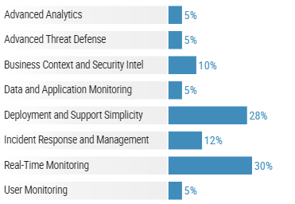
SIEM Capabilities
SECURITY MARKET
Main Capabilities of SIEM

Slide 22
Components of MSS
SECURITY MARKET
FW and NGFW
IDPSs and NGIDPS
UTMS
SWG
Main Components of MSS

Slide 23
Main Components of MSS
SECURITY MARKET
FW and NGFW
IDPSs and NGIDPS
UTMS
SWG
Main Components of MSS

Slide 24





















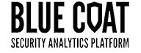


Security Technology by Capability
SIEM &Log Analysis
Structured Data Repositories
Agent Management
*
McAfee
ePolicy
Orchestrator
Structured data visibility & collections
APT Detection/Sandboxing
End Point Detection and Response
Automated or Manual Endpoint response scans, collections, investigations, & remediation
Automated Response for Alerting Technologies
Alerts sent
Wildfire
Intrusion Prevention (IPS)
Static & Dynamic Malware Analysis, and Threat Intelligence enrich validation
Forensic-level visibility for trusted analysis and fast response
Cisco
Network Security Analytics
Intelligence
DFIR Workflow
Cisco
IOCs
Forensics
EITT
IOCs
MFT
Strings
Prefetch
Entropy
RegRipper
Volatility
PDF Parser
USNJRNL
Your Organization
Notes:
Automated Response Integrations are technologies that are able to pass information pertaining to detected security events to EnCase Cybersecurity/Endpoint Security for the purposes of validating that the detected event affected the indicated endpoints, prioritization based on the existence of sensitive data, provide context in the form of capturing RAM at the time of the alert, and enabling remediation. Here is a summary of the categories of partner technologies we integration with to that effect.
SIEM : Security information and event management (SIEM) is a term for software products and services combining security information management (SIM) and security event management (SEM). SIEMtechnology provides real-time analysis of security alerts generated by network hardware and applications.
Data aggregation : Log management aggregates data from many sources, including network, security, servers, databases, applications, providing the ability to consolidate monitored data to help avoid missing crucial events.
Correlation : looks for common attributes, and links events together into meaningful bundles. This technology provides the ability to perform a variety of correlation techniques to integrate different sources, in order to turn data into useful information. Correlation is typically a function of the Security Event Management portion of a full SIEM solution^{[6]}
Alerting: the automated analysis of correlated events and production of alerts, to notify recipients of immediate issues. Alerting can be to a dashboard, or sent via third party channels such as email.
In computer security, a sandbox is a security mechanism for separating running programs. It is often used to execute untested code, or untrusted programs from unverified third parties, suppliers, untrusted users and untrusted websites.^{[1]} A sandbox typically provides a tightly controlled set of resources for guest programs to run in, such as scratch space on disk and memory. Network access, the ability to inspect the host system or read from input devices are usually disallowed or heavily restricted.
In the sense of providing a highly controlled environment, sandboxes may be seen as a specific example of virtualization. Sandboxing is frequently used to test unverified programs that may contain a virus or other malignant code, without allowing the software to harm the host device.^{[2]}
Intrusion prevention systems (IPS), also known as intrusion detection and prevention systems (IDPS), are network security appliances that monitor network and/or system activities for malicious activity. The main functions of intrusion prevention systems are to identify malicious activity, log information about this activity, attempt to block/stop it, and report it.^{[1]}
Network Security Analytics (aka network forensics) is a sub-branch of digital forensics relating to the monitoring and analysis of computer network traffic for the purposes of information gathering, legal evidence, or intrusion detection.^{[1]} Unlike other areas of digital forensics, network investigations deal with volatile and dynamic information. Network traffic is transmitted and then lost, so network forensics is often a pro-active investigation.^{[2]}
Content Repositories are technologies we integration with from the perspective of enabling eDiscovery collections in the Cloud. While there are other cloud repositories we integration with such as Google Doc and Amazon S3, only Box and DropBox are partners we are engaged with on go-to-market activities.
Threat Intelligence vendors provide information about unknowns collected with EnCase for the purposes of assessing if the unknown is or is related to known malware.
Agent Management technologies, such as McAfee ePolicy Orchestrator (ePO) are able to push and pull our servlet (agent) and monitor its status across the endpoint it is installed on.

Slide 25







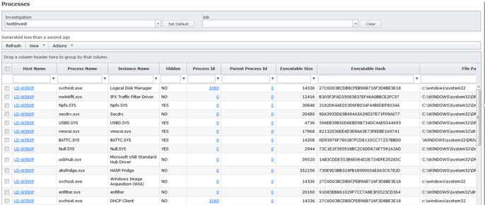

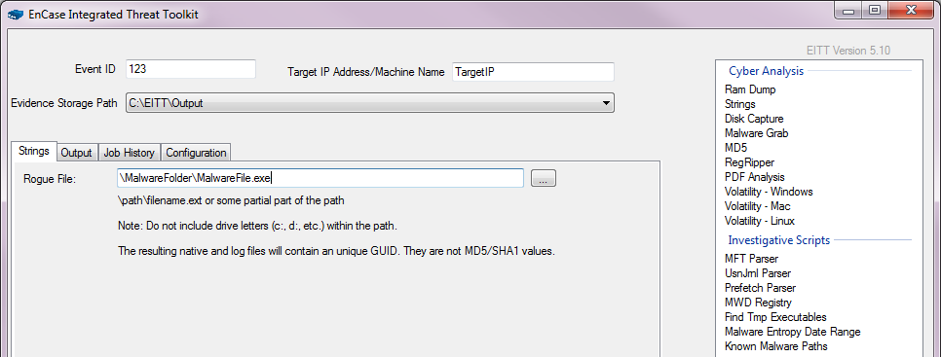

How Can Technology Stop an Attack?
Target
Attacker
Alerting technology
Snapshot of target
Results
Running processes
(Validation)
Open ports & N/w connections (Scope Assessment)
Existence of sensitive data (Prioritization)
And more…
System snapshot running processes
IP Addresses, Hashes
Deep forensic analysis & EITT
Endpoint Detection and response
Notes:
Note: Alerting technologies can be any notification based security tool, a SIEM, APT engine (fireeye), IDS, etc, etc

Slide 26







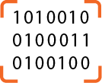

How an Attack Typically Works
DAYS TO WEEKS
SECONDS TO MINUTES
WEEKS TO MONTHS
Our Enterprise
Research
INFILTRATION
Patient Zero
Methodology of an attack
Their Ecosystem
DISCOVERY
Opportunity
EXFILTRATION
CAPTURE
Notes:
Typically, data theft is done in five overall stages.
[0] First, hackers “research” their target in order to find a way to enter the network, this maps to the Lockheed Martin Cyber Kill Chain’s Reconnaissance and Weaponization stages where a security gap is identified and an attack methodology is created to gain network access, commonly attackers using the simplest approach first, maybe running a port scan of a webserver to identify services and applications they may know how to exploit, then move to more time consuming methods like advanced or spear phishing attacks where information from social media sites like Facebook and LinkedIn are used to create targeted email with malicious attachments that are likely to be opened.
[1] Once a weak link is found, the attacker “infiltrates” the network using whichever method they have deemed more accessible, this is Delivery, Exploitation and Installation stages in the Kill Chain where code is delivered to its intended target through a viable entry point, in the phishing example an email will be relevant to a user and be specific enough to entice them to open that malicious attachment, the malicious attachment will have important information so an alarm is not raised but also execute shell code and open a door providing access to that machine and to advance the attack.
This is where typical defenses stop providing intel, if the attack hasn’t been identified at this point or has been but gone unnoticed, its rare that the next stages will be detected. Its also imported to note
[2] We have Our Patient Zero
[3] The “Discovery“ stage normally has two aims, advance the attack and avoid detection. The attacker is enhancing their ability by establishing Command and Control which may well be deploying additional executables that assist in moving laterally within the organization and gathering information until they can take Action on Objectives.
[4] Typically this stage is where they have the most amount of time, the hard part is done, their toolset is strong and due to their agenda and value of their potential findings, they are usually very patient. They may be hired to steal your companys IP, to observe email interactions to learn more about any upcoming M&A activity, sell facebook likes – an unusual one and generally more of a botnet - or they may simply want to steal information about your customer’s profile and credit card information. But whatever date it is, its found and “Captured”.
[5] Once they have secured their target, the next step is to “exfiltrate” the information out of the network usually through a secure or encrypted tunnel, but in rare occasions can also occur from disgruntled or malicious insiders who already have access to your systems through privileged and default accounts, and are harder to catch.
[6] Its these stages between Infiltration and Exfiltration where generally organizations lack visibility and we have opportunity with Endpoint visibility, where Guidance focus’ its effort. Coincidently its also where the majoritiy of time is spent for the attack, infiltration and exfiltration happen fast and have narrow detection windows.
[7] And then of course once its out, its out and attackers look seek a return on their time investment, your data.
If you would like to read up on the Lockheed Martin Cyber Kill Chain, here are some links
http://www.darkreading.com/attacks-breaches/deconstructing-the-cyber-kill-chain/a/d-id/1317542
http://www.lockheedmartin.com/us/what-we-do/information-technology/cybersecurity/tradecraft/cyber-kill-chain.html
http://www.lockheedmartin.com/content/dam/lockheed/data/corporate/documents/LM-White-Paper-Intel-Driven-Defense.pdf

Slide 27
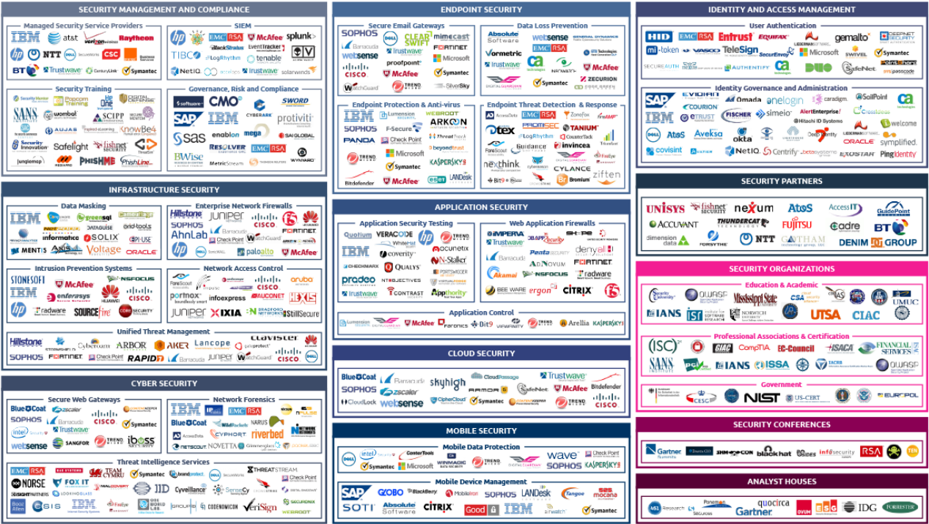
The Cybersecurity Landscape

Slide 28
The Major Players – Revenue in Security BU
Check Point Software - $16 billion
Palo Alto Networks - $12.5 billion
Symantec Corp. - $12.5 billion
Trend Micro, Inc. - $5.4 billion
Fortinet, Inc. - $5.2 billion
FireEye, Inc. - $3 billion
Proofpoint - $2.6 billion
Imperva, Inc. - $1.5 billion
CyberArk Software, Ltd. - $1.3 billion
AVG Technologies - $1 billion
Qualys - $980 million
Sophos - $903 million
IBM - $2 Billion
Cisco - $1.75 Billion
Hewlett Packard - $1 Billion
EMC (RSA) - $1 Billion
Secureworks - $800 Million
Intel (McAfee) - $790 Million

Slide 29
Cybersecurity Competitive Landscape
Security Management and Compliance
  MSSP’s, SIEM’s, Training and GRC
Infrastructure Security
  Firewalls, IDS/IPS, Unified Threat Management, Network Access Control
Cyber Security
  Threat Intelligence, Network Forensics, Secure Web Gateways
Endpoint Security
  Secure e-mail Gateways, DLP, Endpoint protection and antivirus, EDR
ID/Access Management
  User Identification, Identify Governance and Administration
Application Security
  Testing, Web App Firewalls,
Cloud Security, Mobile Security, etc….

Slide 30
SIEM Competitive Landscape?
ArcSight
Alien Vault
Log Rhythm
Tenable
Splunk
RSA

Slide 31
MSSP Competitive Landscape
SecureWorks
NTT
CenturyLink
IBM
HP
Telecoms – AT&T, BT, Verizon

Slide 32
FIREWALL Competitive Landscape?
Cisco
Palo-Alto
Check Point
McAfee
Baracuda

Slide 33
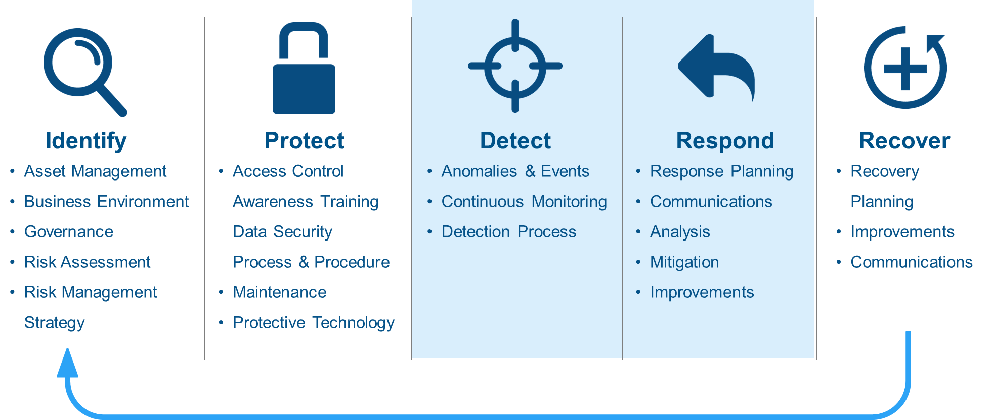
What is the NIST Cybersecurity Framework
Notes:
The final version of the NIST Cybersecurity Framework was published by the National Institute of Standards and Technology (NIST) in February 2014 as a voluntary standard to achieve cybersecurity best practices for the agencies Managing, and the industries serving, critical infrastructure in the United States.
The functions that NIST identified as critical to institutional understanding and cybersecurity risk management are Identify, Protect, Detect, Respond, and Recover. EnCase Endpoint Security from Guidance Software can simplify the process of bringing your organization’s security tactics and processes into alignment with requirements of the Identify, Detect, and Respond functions of the NIST Cybersecurity Framework.
EnCase Endpoint Security in each phase:
Identify: Access Management
ID.AM-1 and 2
Inventory physical devices and software applications
Detect: Anomalies and Events
DE.AE-1 to 5
Baseline of users and systems, detect events and understand attack targets, aggregate and correlate event data from multiple sources, understand the impact and establish alert thresholds
Detect: Security Continuous Monitoring
DE.CM-1,3,4 and 6
Detect malicious code and cybersecurity events on the network, in personnel activity and external provider activity.
Respond: Analysis
RS.AN-1 to 4
Investigate notifications from detection systems, understand impact , perform forensic analysis and categorize according to response plans
Respond: Mitigation
RS.MI-1 to 3
Contain and mitigate incidents and newly identified vulverabilties

Slide 34
MSS Competition

Slide 35
Dell Secureworks
The vendor offers a full suite of MSS, as well as threat intelligence, incident response and security consulting services
MSS delivery is based largely on its proprietary Counter Threat Platform (CTP) technology, which leverages big data analytics and machine learning to complement traditional threat detection approaches
Commercial and proprietary tools are used for network and host-based advanced threat monitoring, and log retention services deployed on customers' premises
The SecureWorks Counter Threat Unit research team provides threat intelligence, malware analysis and analytics support to the SOCs and customers
Over the last 12 months, midmarket and small-enterprise Gartner clients have increasingly reported dissatisfaction with SecureWorks' MSS delivery and post sales experience
Gartner clients have increasingly reported that SecureWorks' pricing is more expensive relative to other MSSPs

Slide 36
Optiv
Optiv is a pure-play security service company offering a broad range of security consulting, implementation and outsourcing services
Most of Optiv's revenue comes from its VAR business, although it does have significant revenue in security consulting and MSS
The company also offers threat intelligence and co-managed SIEM services as well as Carbon Black for proactive threat hunting
Merger between Accuvant and Fishnet in 2015 have caused tremendous issues internally which has leaked into customer engagement
Gartner does not see Optiv being very visible in stand-alone MSS deals and was left out of the 2017 Magic Quadrant report

Slide 37
NTT Solutionary
NTT Security offers a broad range of security professional services, and integration and incident response services
The MSS delivery capability is now based on three delivery platforms
NTT plans to integrate the ActiveGuard and WideAngle platforms as the basis for future MSS delivery
Proprietary network behavior analysis developed by NTT is employed and Support is provided for third-party, commercial EDR solutions
Incident response retainer services are available globally and are also available remotely to customers using supported endpoint agents (Forensic, EDR)
NTT is struggling as it tries to manage delivery platforms and different technologies
MSS will be sold, and customer relationships managed, by NTT operating companies and their strategic partners, with services delivered by NTT Security which has led to customer confusion

Slide 38
Verizon
Over the past 12 months, Verizon completed its move to the MSS Analytics platform and introduced its new Unified Security Services Portal for customers
Verizon's log event collector (LEC) is used to feed customer security data to Verizon's proprietary big databased analytics platform, along with Splunk, for automated analysis, visualization and log storage
Advanced threat detection capabilities are available from Verizon's Advanced Threat Intelligence and Monitoring Service malware analysis and network and
Endpoint forensics, is available via professional services or Verizon's Rapid Response Retainer service
Verizon is still in the process of moving customers to its new unified portal and back end and the migration has caused customer issues
Very expensive and is based on data volumes which customers complain is unpredictable

Slide 39
Masergy
Managed networking and cloud services Based in Plano, Texas – over $250 Million in revenue – just purchased by Berkshire Partners in 10/2016
Majority of revenue appears to come from hardware and software networking devices
Unified Enterprise Security (UES) provides a single console that delivers unified reporting and comprehensive administrative tools
UES appears to integrate SIEM and packet sniffer information in a “single pane of glass”
Masergy Managed Next Gen Firewall solutions are available stand alone or fully integrated with our UES managed solution

Slide 40
IT Security Technology

Slide 41
CARBON BLACK
Company Information
Formerly Bit9, Inc.
Acquired Confer in July 2016 to offer a NGAV solution
Rumors have been floating as recent as June that Carbon Black will IPO as soon as this year. Morgan Stanley and JPMorgan Chase will lead the IPO.
Founded in 2002 in Waltham, Massachusetts
200-500 employees

Slide 42
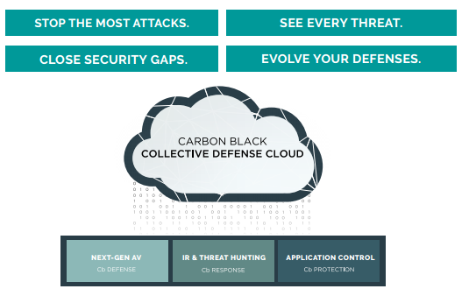
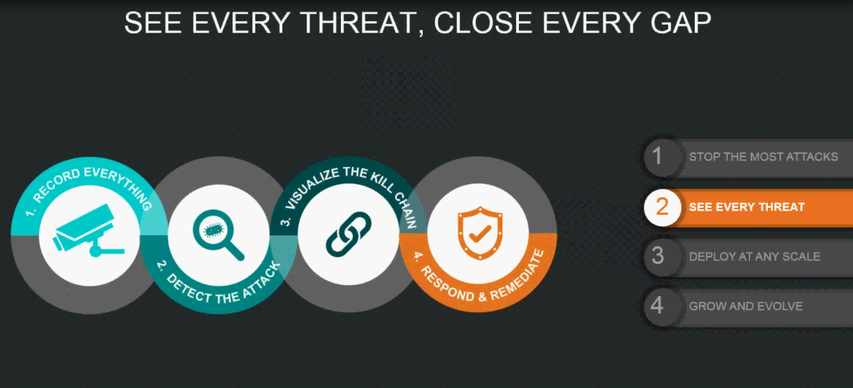
CARBON BLACK
Competitive Positioning
Carbon Black Collective Defense Cloud
Gather continuous data (file, network, process, registry, etc. from 7M endpoints)
Uses threat intel from 20+ threat intel feeds, intelligence contributed by Cb’s Detection eXchange, Cb threat research
Continuous Recording
Live response and attack recovery
Immediate endpoint threat isolation and real-time remediation
1 Endpoint Security Platform with 3 specific solutions
Cb Defense – Acquired Confer, a NGAV solution. Protects against malware and malware-less attacks, monitors attack behaviors. “Zero-Gap Protection” Approach
Cb Enterprise Protection - Policy-based, automatic whitelisting
Cb Enterprise Response - Visibility, root cause analysis
Value Proposition – Continuous Recording, Application Whitelisting, NGAV, One-Stop shop for security

Slide 43
CARBON BLACK
Features
Does not offer forensic analysis
Forensic analysis isn’t offered at the file level.
Continuous Monitoring (Cb Response)
Captures and hunt threats in real time, root cause, impact of attack
Collects and records information to as far back as you want, it is configurable based on the number of endpoints and data retention you desire.
All data is stored in centralized server
Capture all threat activity such as file modifications, cross-process events, registry modifications, file executions, copy of every executed binary, network connections
All data accrued is cached every 30 seconds to 2 minutes and sent to back-end server
No scanning or polling on endpoint, between than 0-3% CPU Usage
Network bandwidth for backup server. For high analysis, 60-80 Mb per day

Slide 44
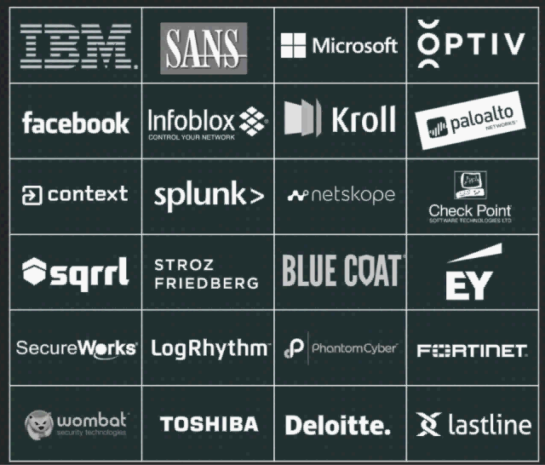
CARBON BLACK
Features
Supported OS
Defense-Windows XP SP3 and Up, OSX 10.6 to 10.11. Made a strategic decision
to pull out Android
Windows and MAC
Response-Windows, MAC, RedHat 6.4-6.7, CentOS 6.4-6.7
Both Response and Defense are offered as a cloud-based solution, so there
aren’t any storage requirements. (Response also has an on-prem offering)
Integration
Open API
Carbon Black Ecosystem:
50+ Integrations
75+ IR/MSSP Partners
10,000+ Practitioners
Signature-less Malware Detection
Detects malware without signatures through Cb Response and Defense.
Utilizes behavioral analysis, TTP (machine learning capability)
Collects binaries, takes logs, processes information, cross process events, file mods, registry mods, network connections, binary info, binary module loads, non-binary file rights, log-in events, USB activity (one of the biggest selling points for them)
Detection eXchange is a Carbon Black customer community focusing on threat intelligence
Incident Response
Blocks malware incident
Option to ban hash throughout the network and isolate the endpoint.
Can kill processes and ban future executions of processes across all hosts based on hash during remediation.
No surgical remediation
Red Hat Linux, OS server hosted in the cloud

Slide 45
CARBON BLACK
Features
Prevention (Cb Defense)
CPU <1% Disk <1% Max 3.5 Mb/Day
Eliminate known and unknown malware before it executes
Block sophisticated malware patterns that may be evading threat intelligence
Halt Malware-less attacks based on malicious behaviors.
Can auto ban things based on a score of 5 or higher. Can black or whitelist hashes of files and executables. Can also auto-blacklist known bad threats based on score threshold.
Looks at the behavior of the process and the reputation and trust of those services, while Cylance looks at the attributes of a file through linear algebra and sends updates out every 6 months.
Protection (Cb Protection)
Application Whitelisting and Blacklisting (goes on more critical machines)
3 levels of prevention: Low enforcement, Medium, and High
High enforcement - default deny, only things approved by IT will be allowed to run
Medium enforcement - prompt user when downloading software and user will get a notification
Low enforcement - execute and track, get the visibility to know what's running and where

Slide 46
CARBON BLACK
Features
Threat Intel
Threat Intel Feeds: Facebook, SANS, Fidelis, National Vulnerability Database, ThreatConnect, VirusTotal + many others.
Proprietary Threat Intel + Many threat intel integrations
All info received is being fed through the cloud
Comes with each product out of the box
Pricing
Sold exclusively through the channel.
1 year and 3 year subscription model
1,500 endpoints. 3 servers:
Protection: $31/endpoint. $150/server
Response: $31/endpoint. $31/server

Slide 47
FIREEYE Profile
What Do They Do?
FireEye and Mandiant have a full portfolio of products designed to detect advanced threats and the NX model is their network appliance. The NX can operate at bandwidths up to 10Gbps and interoperates with the central management system. Their Enterprise Network Security solution is comprised of a variety of components designed to solve specific issues such as e-mail and servers and can be centrally managed from the CM product
Value Proposition
The FireEye Enterprise Network Security solution enables you to rapidly detect and respond to today’s evasive threats missed by traditional defenses, across all major threat vectors—network/web, email, and file systems. This integrated intelligence helps you prioritize threats with rich contextual insights, stay informed on the threat landscape and the attackers, and get the most out of your resources and budget by having 24/7 remote monitoring of FireEye appliances
Points of DIFFERENTIATION
No capability for monitoring lateral east-west traffic, no capability to assemble security events into a single timeline
No capability to remediate infected hosts
Very expensive and has earned low marks by industry experts and its own customers for an inability to stop threats

Slide 48
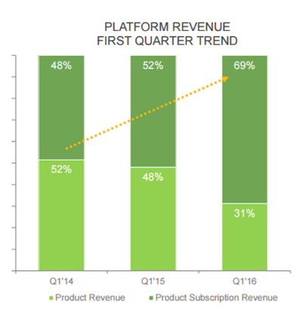
FIREEYE
Company Information
Located in Milpitas, CA
Kevin Mandia took over as CEO in June
Leaders in exploit detection and threat intelligence
3,400 employees- Plans to layoff 300-400 employees due to quarterly sales that missed its own forecast. Will reduce annual costs by about $80M
FireEye is embracing a service-based business model. Their customers are shifting their spending to subscriptions and FaaS.
FaaS provides continuous compromise assessment and response by using FireEye products and intelligence to detect signs of intrusion. Utilizes enterprise forensics
Integrations with Splunk, IBM Security Intelligence, OpenDNS, ThreatSync, and others
Recently released version HX 3.1. New features include:
Exploit Guard. Applies behavioral analysis and machine intelligence techniques to evaluate individual endpoint activities and correlate this data to detect an exploit.
Host Based Workflow, a new UI page that unifies individual hosts current alerts, system details, and acquisitions. The new interface is deigned to improve workflows.
Recently acquired iSIGHT, global cyber threat intel company

Slide 49
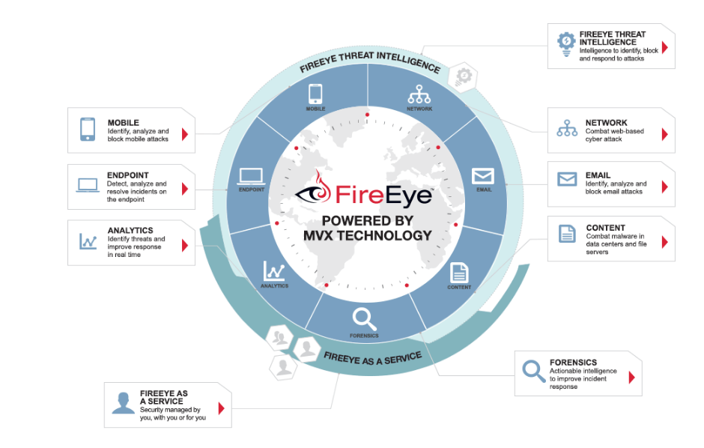
FIREEYE
Competitive Positioning
“Worlds largest cyber threat intelligence database”
Prioritize NX over HX (their network security solution)
Detect known and unknown threats at any endpoint using security search
Enhanced endpoint visibility for on- or off- premise endpoints (“Agent Anywhere”)
Immediate containment
Value Proposition – “Best threat intel in the world”

Slide 50
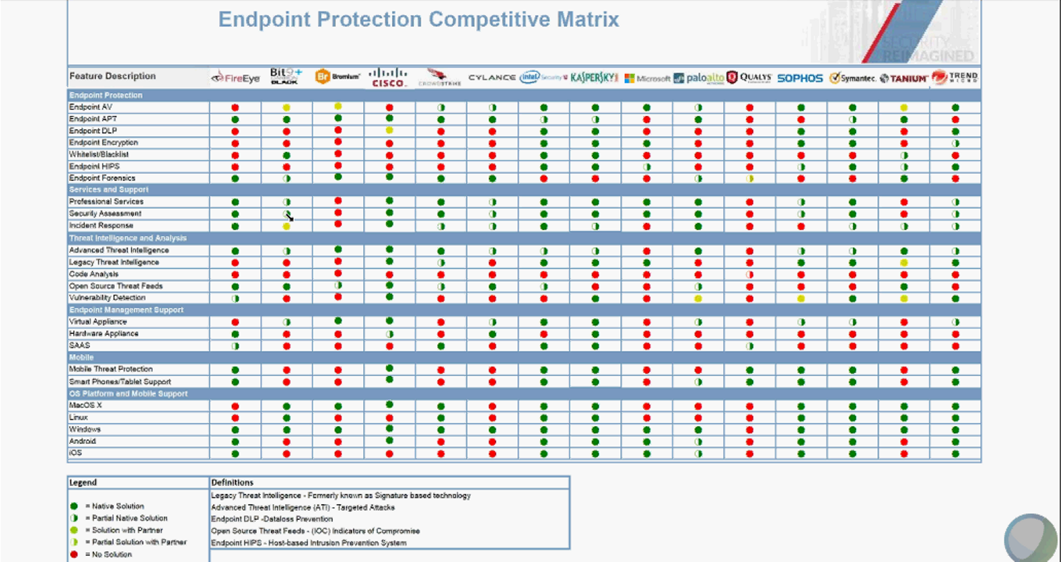
FIREEYE
Features

Slide 51

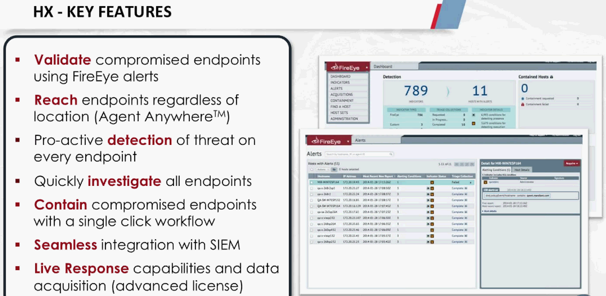
FIREEYE HX
Features
Forensic Analysis
Offers forensic capabilities at a premium
FireEye HX Advanced product performs raw
process memory analysis, raw disk analysis,
registry listing, windows event logs
Continuous Monitoring
Offers “FireEye as a Service”
Monitor networks and endpoints 24/7 using
proprietary methods to actively hunt for signs of compromise
IOC Driven- Conducts endpoint investigations to identify and contain IOCs and create event timelines with Triage Viewer

Slide 52
FIREEYE HX
Features
Supported OS
Windows
Integration
Integration with Splunk, OpenDNS, Imperva SecureSphere Bluecoat, VirusTotal
40+ integration consultants
Signature-less Malware Detection
Detection performed via IOC matching (provided by FireEye) and exploit detection rules.
Exploit Guard, relies on threat intel, to detect exploit processes on endpoints
Offers Behavioral Analysis on their Threat Analytics Platform (cloud-based)
Historical data is only saved for up to 48 hours
Data collected by a manual search query and triage data are stored longer term on the server
Incident Response
Contain compromised endpoints and prevent lateral spread.

Slide 53
FIREEYE HX
Features
Prevention
No prevention capabilities
Threat Intel
Uses threat intelligence to correlate alerts generated by FireEye network platforms, log management, and network security products with IOCs on any endpoint
Feeds from both cloud and network intelligence sources
Proprietary threat intel included and would feed into product (IOCs)
Acquired iSIGHT, claims threat intel is their biggest differentiator
iSIGHT is offered as an add on service:
Top targets, reports of what's going on in the industry, etc.
Does not start below $350K
Pricing
List Price
For 1500 Endpoints, $118K, discount hardware at 50%, one sitting on the endpoint

Slide 54
CROWDSTRIKE
Company Information
Located in Irvine, CA
Deployed in 170 Countries
Backed by Google Capital, Accel, Warburg Pincus
CrowdStrike ranked #144 on Inc. Magazine 5000 of the fastest growing companies, named 2015 technology pioneer by World Economic Forum

Slide 55
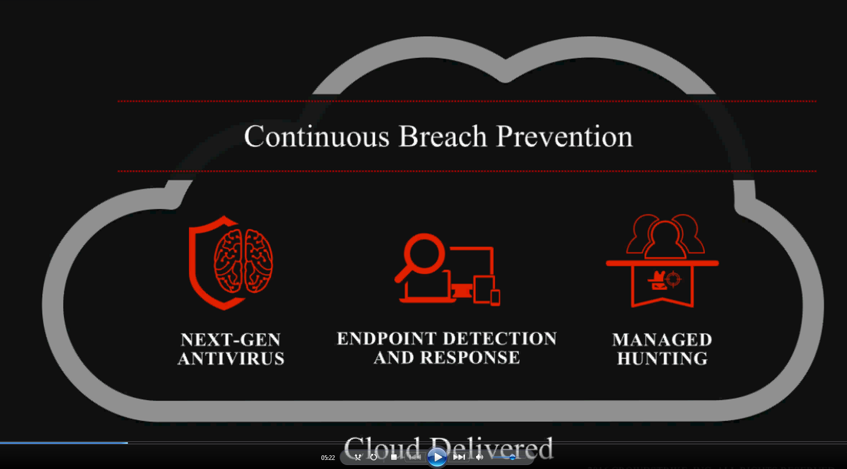
CROWDSTRIKE
Competitive Positioning
“Continuous Breach Prevention”
Platform-First model. 90-95% of their customers purchase
the Falcon Host Platform first, and then their services.
Next-Gen AV
Machine Learning
Block Known Bad
IOA Behavioral Blocking
Exploit Mitigation
Differentiators-Agent 4.5 MB, sits on kernel, Cloud Based,
No hardware
DVR for Endpoint
5-Second Enterprise Search
Full Spectrum Visibility
24x7 Breach Prevention Services
Value Proposition – Leverage Customer Threat Intel, Reduced time to remediation, Protect against known/unknown malware, Cloud-based

Slide 56
CROWDSTRIKE
Features
Forensic Analysis
Offers Falcon Forensics, which is only available through their IR Services.
Delivered through Falcon Orchestrator, an open source tool built on CrowdStrike’s Falcon Connect APIs
Extensive forensics collection capabilities that augment and optimize existing workflows with CrowdStrike Falcon Host data and intelligence.
Memory analysis/processing
Volatility timeline support
Profile-specific tool runs (to remove tools incompatible with specific image types and thus decrease processing time)
Continuous Monitoring
DVR for the endpoint
Looking through endpoint data on a 24/7 basis
Alerts suspicious activity in real time
Can rewind the tape
Data retention policy:
Hot data (active data): 31 days
Anything that matches indicators at all will be stored for 90 days
Offer a separate cold storage environment based on customer needs and is available in the cloud

Slide 57
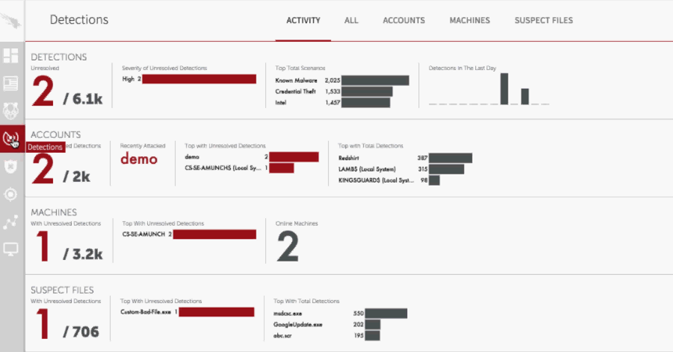
CROWDSTRIKE
Features
Supported OS
Windows x64, x86
Mac OS X
Linux Red Hat
Integration
Tech partners include LogRhythym, RiskVision, Splunk, Anomali, Infoblox,
ThreatConnect, Hexadite, Phantom, Swimlane, Syncurity, Demisto +many others.
Signature-less Malware Detection
The number of detections they generate are very few compared to other solutions because they offer real-time, seeing malicious behaviors as they take place. Only going to push detections into UI for higher confidence indicators. Labels severity of detections.
Machine-Learning analysis in the cloud
Visualizes complete process tree, execution details, network connections, hash details, file path, captures all attacks of commands attacker runs, etc.
Visibility into zero-days and unknowns. Takes all suspicious elements together to write an IOA.
Incident Response
Remotely contain system. Will shut it off and only talk to Falcon Host
Offers incident response services for highly critical instances. Services use Falcon Host, will do full memory scraping, and will use “their own tools” for incident response.

Slide 58
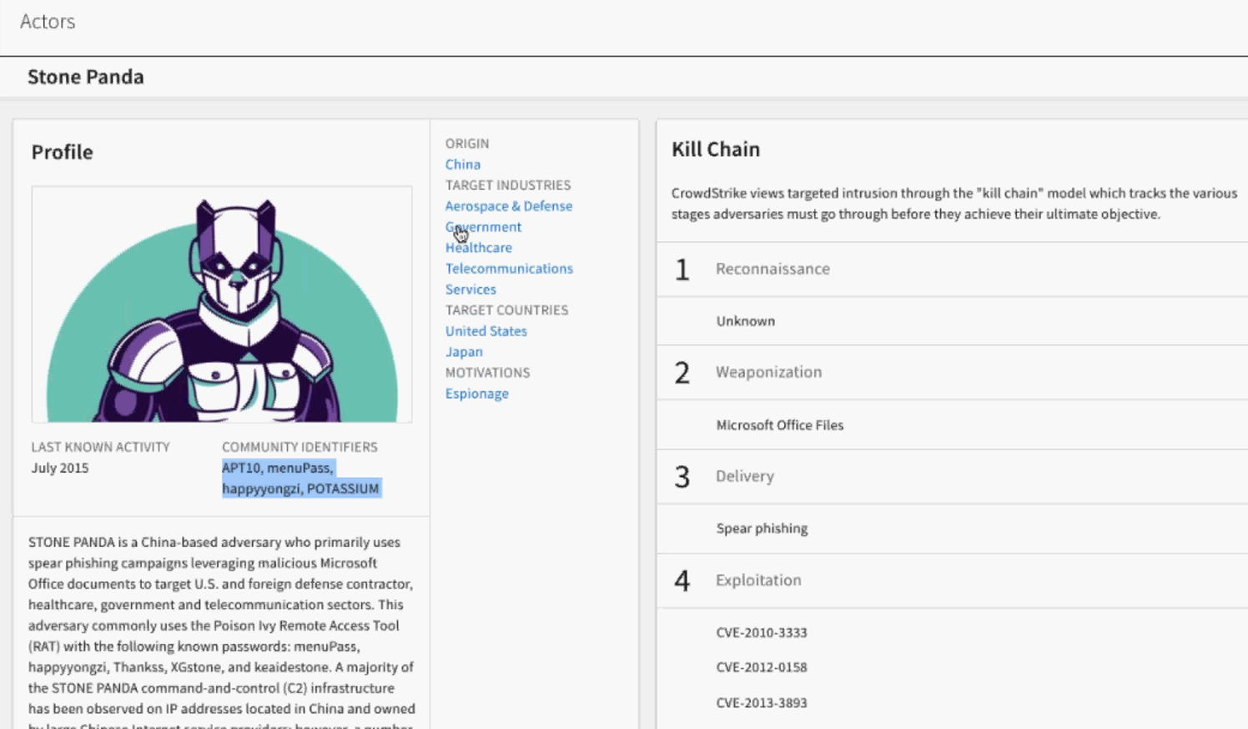
CROWDSTRIKE
Features
Prevention
IOA Approach, intercepting adversary behavior to execute commands
Machine Learning
Block Known Bad
Exploit mitigation-block processes to run
Threat Intel
Offers Falcon Intelligence, and in-depth and historical understanding of
adversaries, their campaigns, and their motivations.
Provides actor profiles, which shows who the actor is, what industries they target, where
they’re from, target countries, and their motivations. Also provides their full kill chain activity that they’re aware of. Tracks 80
different actors.
CrowdStrike ThreatGraph processes, correlates, and analyzes more than 12B events per day from all deployed sensors. Investigates petabytes of historical data adversary activity — at scale and with unprecedented speed.
CrowdStrike Intelligence Exchange Program (CSIX) enables vendor partners to access and share threat intelligence.
Pricing
For 2,000 endpoints and 3 servers. Includes EDR, next gen AV, threat intel actor profiles and attribution, managed hunting, support, and installation
1 year - $90,525
3 year - $230,838.

Slide 59
TANIUM
Company Information
Located in Emeryville, CA
Father and son duo David and Orion Hindawi founded Tanium in 2007 after selling their earlier venture BigFix to IBM for $400 million
Valued at $3.5B
24th on Fortune’s List of the 25 most important private companies. Refers to Tanium as the “Usain Bolt of cyber-security”
Since 2014 the staff has grown from 50 people to 500
Analysts expect Tanium to go public soon
Partner integrations with Palo Alto, Splunk, and Accenture to deliver the Accenture Cyber Defense Platform(ACDP)-Announced at BlackHat

Slide 60
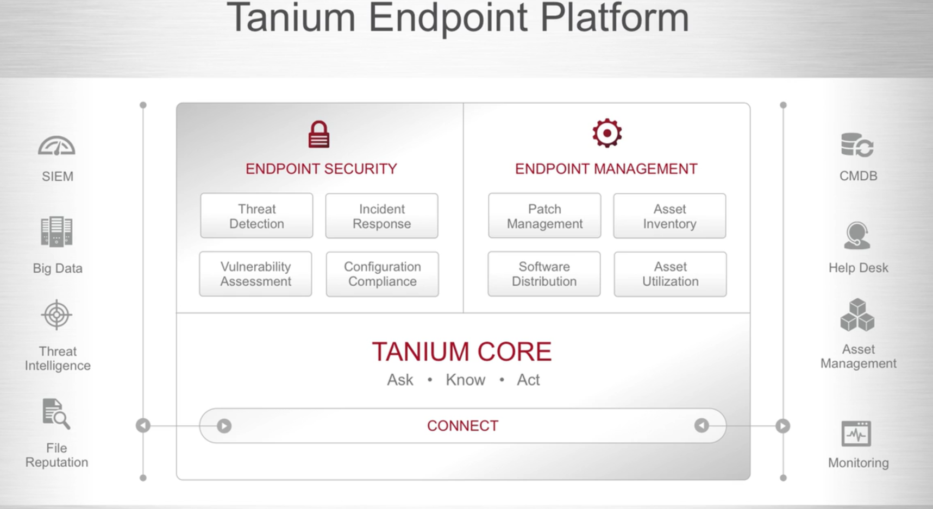
TANIUM
Company Information
15-Second Visibility, scalability
Peer-to-peer system. Avoids deployment of large servers
“Google for your IT infrastructure”
“Only security and systems management platform available to allow you to ask, know, and act in seconds across your entire IT environment”
Take action at scale: change millions of endpoints as needed in seconds
Value Proposition – 15-Second Visibility, Google for your enterprise, P2P

Slide 61

TANIUM
Features
Forensic Analysis
“Tanium Trace” (Released June 2015) conducts live forensic analysis on an individual endpoint
Allows IR teams to search, filter, and visualize forensic data
IR Teams can rapidly conduct live forensic analyses on endpoints remotely
Continuous Monitoring
Continuously recording system activity through Tanium Trace module
Trace records endpoint activities such as file system, process, network connections, hashes for executed processes, registry and security events through kernel-level monitoring
Can detect rootkits or other advanced counter-forensic techniques employed by attackers

Slide 62
TANIUM
Features
Supported OS
Windows
Mac OS X
Linux
Solaris
IBM
Some add-on modules (IOC Detect, IR, Trace) are limited to Windows and Mac
Integration
New integrations with Accenture, Splunk and Palo Alto Networks to develop the Accenture Cyber Defense Platform
Signature-less Malware Detection
Performs on-demand IOC scans or scheduled automated scans at customizable intervals
Uses simple-English language queries
Automated Tanium IOC Detect by translating threat intel data from multiple sources
“Detection on every endpoint in seconds”
Detection achieved by comparing IOC feeds (via Open IOC, YARA, SITX, CybOX or TAXII) to current state or event history. Does not provide its own IOC feeds.
Can evaluate complex IOC attributes, such as filenames, registry settings, IP addresses, MD5 hashes, or
suspicious behaviors
Incident Response Automation
Kill process, deploys patches, get copy of logs, uninstall applications, quarantining machines, shut down machines, collecting data, isolation, notifying the user and marking machines for reimaging
Enables continuous hunting for abnormal anomalous activity

Slide 63
TANIUM
Features
Prevention
Offers Tanium Protect
Leverages AV, firewall, application control
Protection to reduce attack surface and prevent further spread
Creates policies to block malicious network connections or software
Threat Intel
Threat Intel integrations with ThreatStream and iSIGHT Partners, and open platforms like Soltra Edge
Extra cost
Pricing
25K endpoints for 3 years=$2.1M (contract value discounted)

Slide 64
RSA
Company Information
Located in Bedford, MA
Acquired by EMC Corporation
Security division of EMC
EMC Revenue=$24.4B

Slide 65
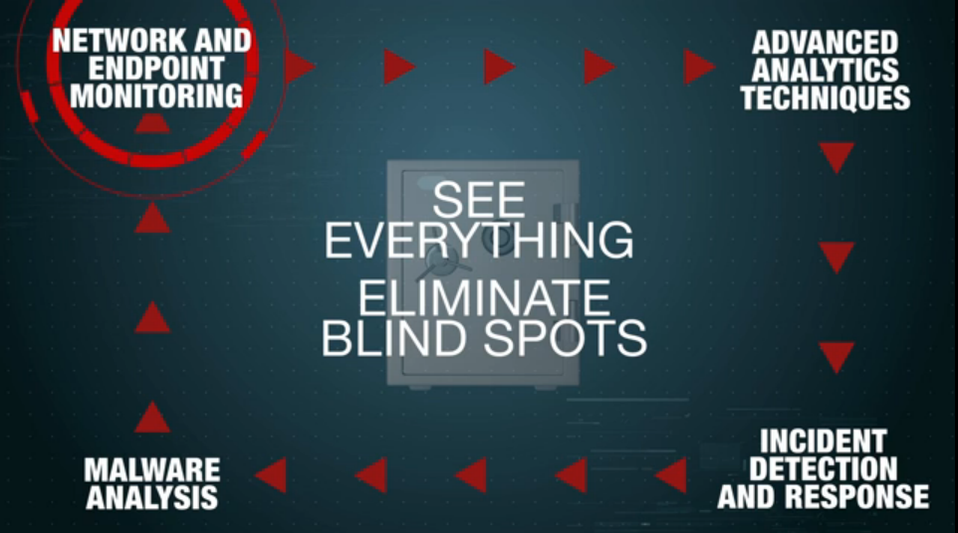
RSA NETWITNESS
Competitive Positioning
“Detect and Response to threats that no other tool can”
X-Ray visibility
Threat-Based Analytics
Reduce dwell time by taking real-time action
Monitors endpoints and leverages scanning techniques
Value Proposition – Using visibility to protect enterprise

Slide 66

RSA NETWITNESS
Features
Forensic Analysis
ECAT facilitates the capture of forensic artifacts for deeper analysis
Can pull full process and memory dumps, view the MFT, and see all modified/
deleted files
Continuous Monitoring
Offers continuous monitoring on and off corporate network
Alerts suspicious activity in real time
Collects endpoint data for investigations

Slide 67
RSA NETWITNESS
Features
Supported OS
Windows
Mac OS X
Integration
Integration with RSA Security Analytics to bring together network, log, and endpoint level security visibility
Integration with OPSWAT’s Metadefender core technology. Leverages it to scan executable files with anti-malware engines
Signature-less Malware Detection
Utilizes behavior analysis of malware
Automated detection of previously unknown malware
Creates a baseline of intelligence based on “known good” applications, then starts highlighting anomalies from machines
Live memory analysis, physical disk inspection, network traffic analysis
Incident Response Automation
Although ECAT can automatically scan, it can not automatically remediate
Identifies malicious file, allows SA to blacklist the file (block and quarantine)
Once quarantined, the file may be deleted from the system
Blocking can be enabled from across enterprise
Cannot change registry keys or repair damaged processes.
Also offers IR as a service

Slide 68
RSA NETWITNESS
Features
Prevention
Leverages whitelisting capabilities delivered by Reversing Labs
Threat Intel
Sold as a separate service
Only solution to integrate threat intelligence across logs, packets, and endpoints
Uses ECAT to identify, collect, and analyze clues which targeted attacks leave behind
Integration with Threat Intel capabilities for proactive mitigation and prevention
Crowdsources threat intel RSA LIVE is a web-based threat intel deliver system used by RSA Security Analytics customers (not available as a standalone product, integrated with and free for Analytics customers)
RSA Live converts threat intel into hundreds of parsers and correlation rules. The intel is then fused with customer data within security analytics
Recorded Future is a new threat intelligence partner
Pricing
$51.99/agent (according to CDW)

Slide 69
RSA NETWITNESS
Takeaways
Feature | Guidance Software | RSA
OS Compatibility | ✔ | ✘
Threat Intelligence | ✘ | ✔
Forensic Analysis | ✔ | ✔
All-in-one solution | ✔ | ✘
Full Surgical Remediation | ✔ | ✘
Continuous Monitoring | ✔ | ✔
Strengths
Threat Intelligence
Continuous Monitoring
Visibility
Weaknesses
Offers Security Analytics as a separate product
Expensive
Remediation ≠ Manual Quarantine

Slide 70
CISCO Profile
What Do They Do?
The Cisco solution is a collection of Ironport for e-mail, Sourcefire IPS, FireSight central management, and ThreatGRID malware analysis. These are separate products and that are loosely integrated and marketed as a strong solution. In addition, the Cisco Collective Security Intelligence ecosystem, Talos Security Intelligence and Research Group, and AMP Threat Grid threat intelligence feeds represent a collection of real-time threat intelligence and big data analytics.
Value Proposition
Cisco Advanced Malware Protection (AMP) provides you with global threat intelligence, advanced sandboxing, and real-time malware blocking to prevent breaches. But because you can’t rely on prevention alone, AMP also continuously analyzes file activity across your extended network, so you can quickly detect, contain, and remediate advanced malware.
Points of DIFFERENTIATION
Loose integration and subsequently very costly to deploy, maintain and use
The integrated solution is time consuming to set up and often takes weeks and the expense of Cisco’s professional services team
Does not monitor north-south (ingress/egress) and east-west (lateral) traffic
No remediation service available
No single pane of glass to aggregate disparate security events

Slide 71
CYPHORT Profile
What Do They Do?
Cyphort’s Advanced Threat Defense Platform is designed to detect advanced threats embedded within web and email traffic – all from a single console. Adaptive sandbox array and machine learning analytics detection that evolves with threats ensuring the latest threat techniques are detected. Endpoint infection verification to focus remediation efforts on truly compromised systems
Value Proposition
Cyphort network-based, next generation APT defense solution evolves as rapidly as the threats it is designed to detect, providing a unique experience by utilizing a single “pane of glass” for threat visibility across an enterprises perimeter and internal networks, ensuring the identification of initial compromised systems, and the ongoing internal threat progression. Cyphort eliminates alert overload by utilizing extensive threat correlation and in-depth context for your infrastructure. from detection to remediation and is able to be deployed across an enterprises global infrastructure quickly as flexible physical, virtual or cloud appliances.
Points of DIFFERENTIATION
Does not monitor east-west (lateral) traffic
No remediation service available for infected hosts
No ability to aggregate disparate security events into a unified timeline
Few customers take advantage of 3rd party integration to build more robust solution

Slide 72
LANCOPE Profile
What Do They Do?
The Lancope Stealwatch product line own by Cisco is made up of a variety of products that together collect network data, display that data in “single pane of glass” and provide visibility to the applications or processes that are being run on the network. Further, they have a TIC-like product that provides intelligence on malware and another separate product that allows administrators to identify the IP addresses associated with the attack.
Value Proposition
With the StealthWatch Management Console (SMC), administrators can easily view, understand and act upon a plethora of network and security data all through a single interface. Snapshot views and sophisticated drill-down capabilities provide the exact level of information you need exactly when you need it. Dynamic querying, customized reports and intuitive visualizations of network data enhance the advanced threat detection capabilities of the StealthWatch System, helping to decrease the time between problem onset and resolution.
Points of DIFFERENTIATION
Lancope requires analysts to piece together data to get a full picture of events – TSN provides that aggregated data in one Thression view.
The Lancope netflow DPI metadata is not as extensive as TSN
No IDS detection features
No file behavior detection

Slide 73
TANIUM Profile
What Do They Do?
Tanium is an OS-level agent-based platform that lets users find vulnerabilities by querying systems using plain English (e.g. “Find machines running Windows 8”) and install software or patches on endpoints using a peer-to-peer architecture for distribution and communication across machines on the network.
Value Proposition
Tanium Protect enables organizations to more effectively leverage commonly deployed native operating system controls (e.g anti-virus, firewall, application control, etc.) by simplifying and improving the effectiveness of their management. Tanium's patented endpoint communications architecture provides 15-second visibility and control across every endpoint on the network, and can easily scale to millions of endpoints without requiring ongoing infrastructure additions.
Points of DIFFERENTIATION
Assumes that all threats can be stopped at the end point - but no ability to address non-end user devices like servers that may be acting maliciously
Has no view of network activity and extent and frequency of attacks within the network
Cannot show the progress of advanced attacks
Only deals with Windows end user devices

Slide 74
BROMIUM Profile
What Do They Do?
Unlike traditional endpoint security, such as AV or virtual containers, Bromium uses its unique micro-virtualization technology to protect across all major attack vectors by isolating each user task in a lightweight, CPU-enforced micro-VM. Bromium technology places every user task in a secure micro-VM, so endpoints are protected against both known and unknown attacks, including zero-day attacks, drive-by downloads, malvertising, spear-phishing attacks and advanced persistent threats (APTs).
Value Proposition
Bromium’s CPU-enforced task isolation on the endpoint to eliminate enterprise breaches and enable users to click on anything, anywhere, without getting compromised. Security professionals can eliminate the need for urgent patching because systems exist in a virtual environment. The 3 modules are deployed, managed and orchestrated by Bromium Endpoint Controller, a scalable management system. The management server is engineered to reliably manage hundreds of thousands of enterprise endpoints.
Points of DIFFERENTIATION
Assumes that all threats can be stopped at the end point - but no ability to address non-end user devices like servers that may be acting maliciously
Has no view of network activity and extent and frequency of attacks within the network
Cannot show the progress of advanced attacks
Only deals with Windows end user devices

Slide 75
BLUECOAT Profile
What Do They Do?
Blue Coat Security Analytics Platform leverages full packet capture capabilities to act like a security camera on the wire. Blue Coat Security Analytics leverages this full network traffic visibility to deliver advanced network forensics and real-time threat detection for all network activity. This enables enterprises to identify and detect advanced malware crossing the network and analyze and contain via blocking zero-day attacks and APTs—while allowing comprehensive forensic investigations and incident response to swiftly resolve security breaches.
Value Proposition
The Blue Coat Security Platform integrates sophisticated technologies to deliver protection against the full spectrum of security threats. This Advanced Threat Protection capability safeguards your organization from advanced persistent threats, detects sophisticated malware, and automates the containment and resolution of incidents that have occurred. It does so as the traditional network perimeter dissolves, the migration to cloud infrastructure grows, encrypted traffic becomes ubiquitous, and the endpoint evolves at a revolutionary pace.
Points of DIFFERENTIATION
Blue Coat is strong in SSL proxy visibility but it does not monitor internal and lateral network activity
Blue Coat offering is a collection of products that are not well integrated making a single view very difficult
No Thression capability to associate threats with network activity to investigate attack progression

Slide 76
END
Competing Effectively
MSS Competition & IT Security Technology
A Hitachi Group Company

Slide 77
Notes:
本日は有難うございました。

